Slide 1
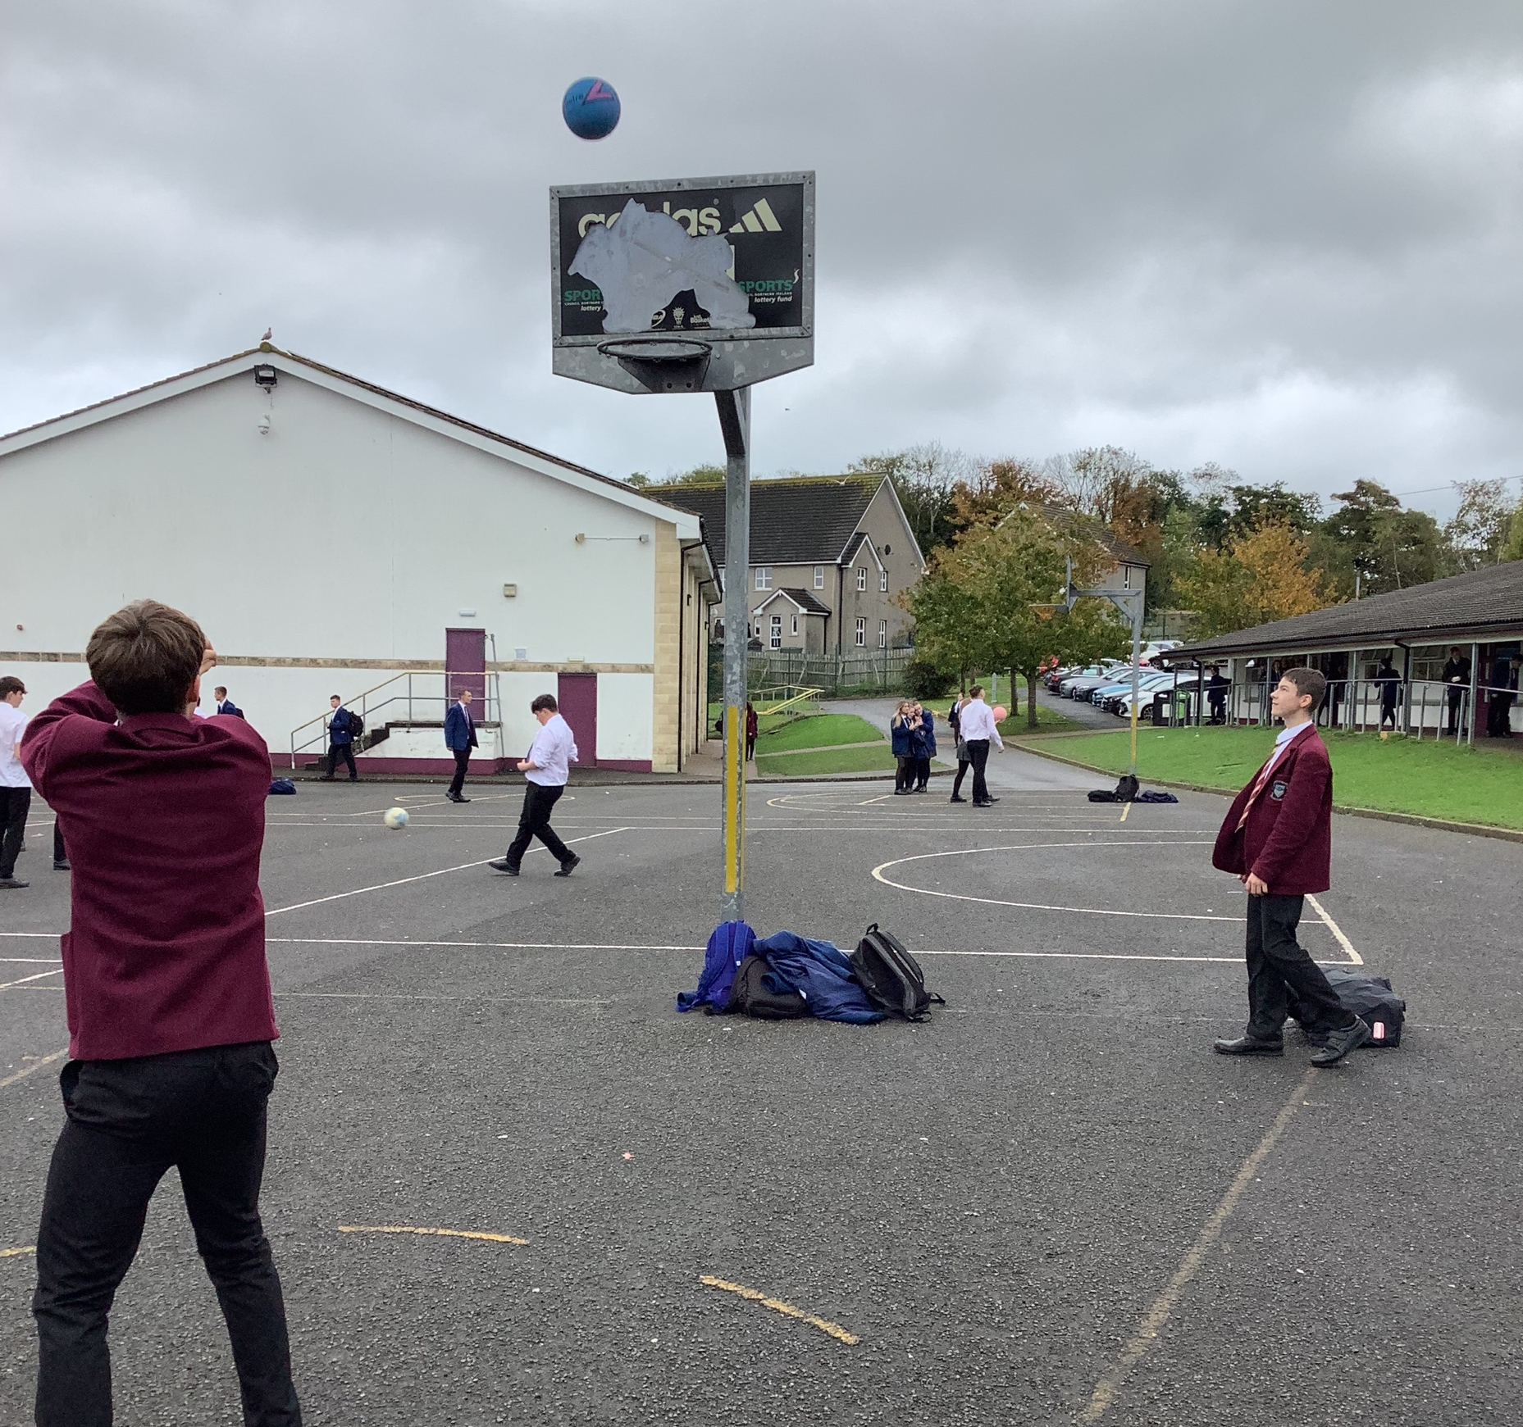
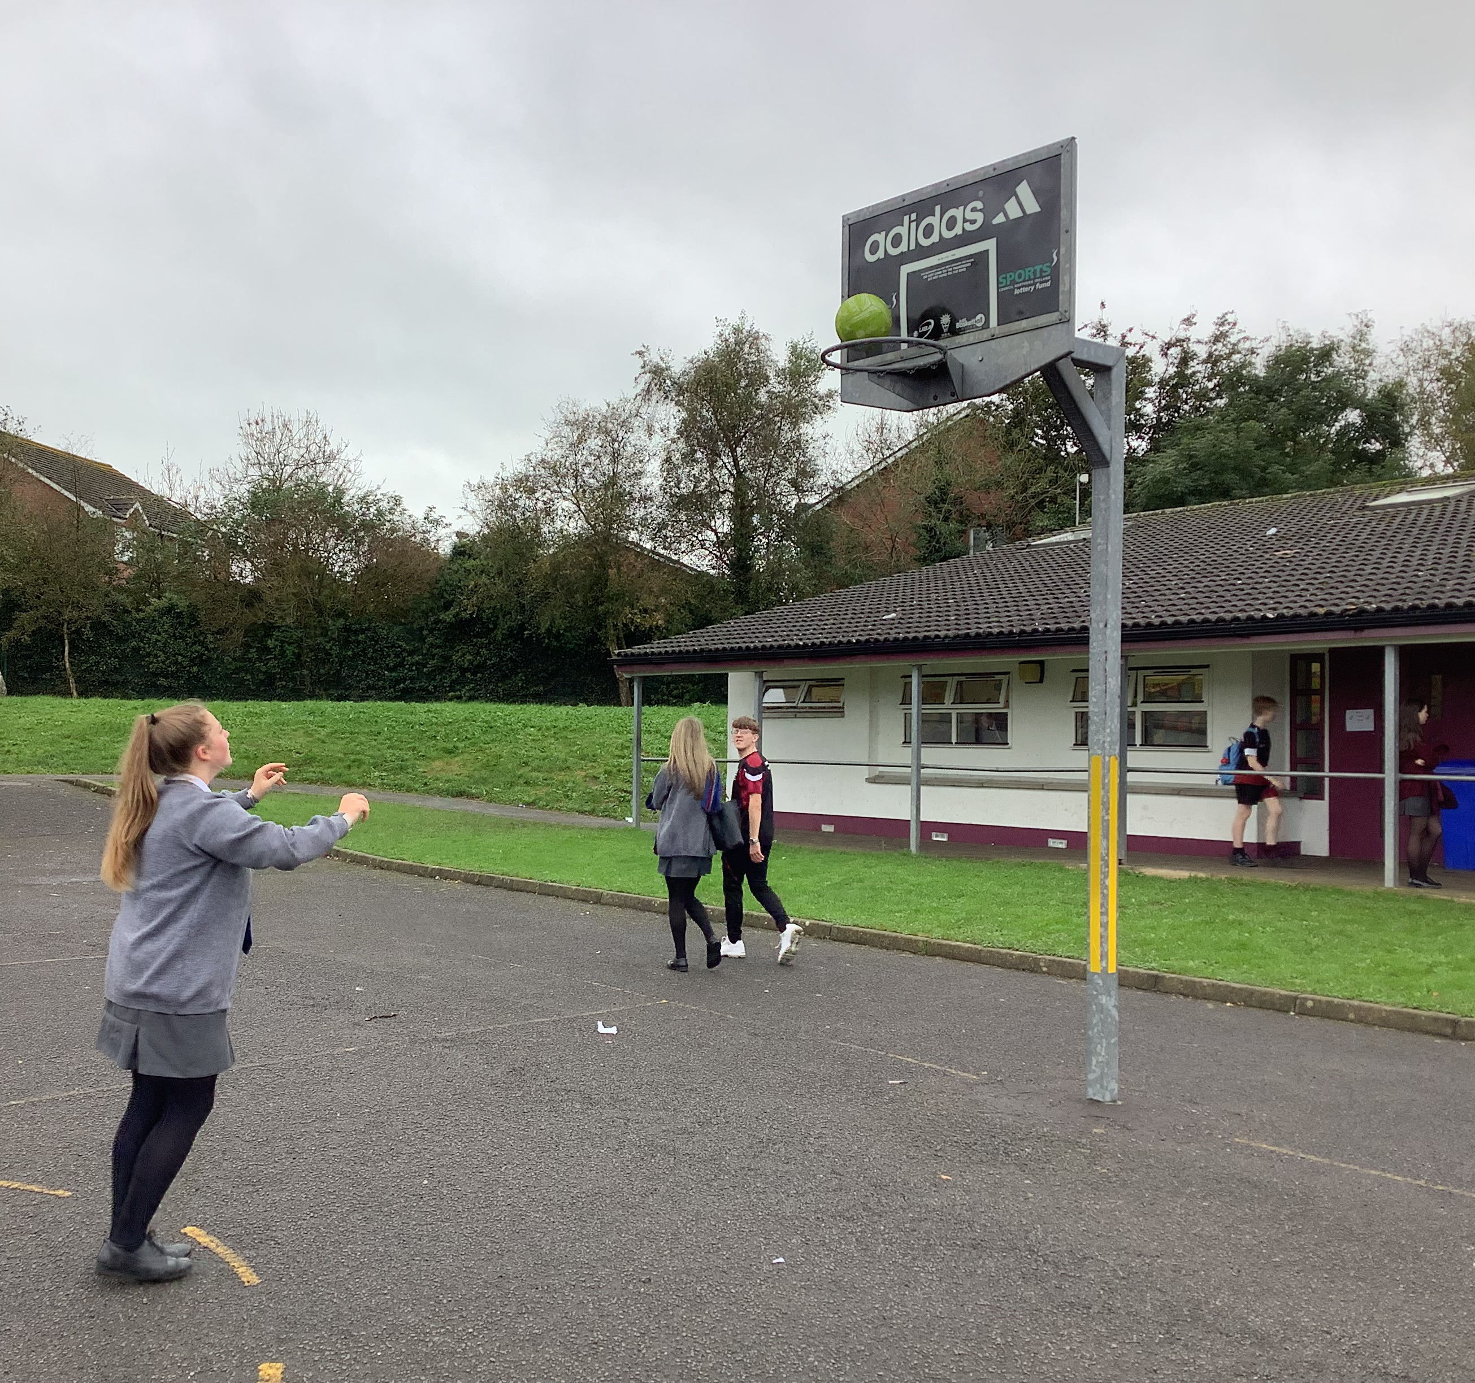
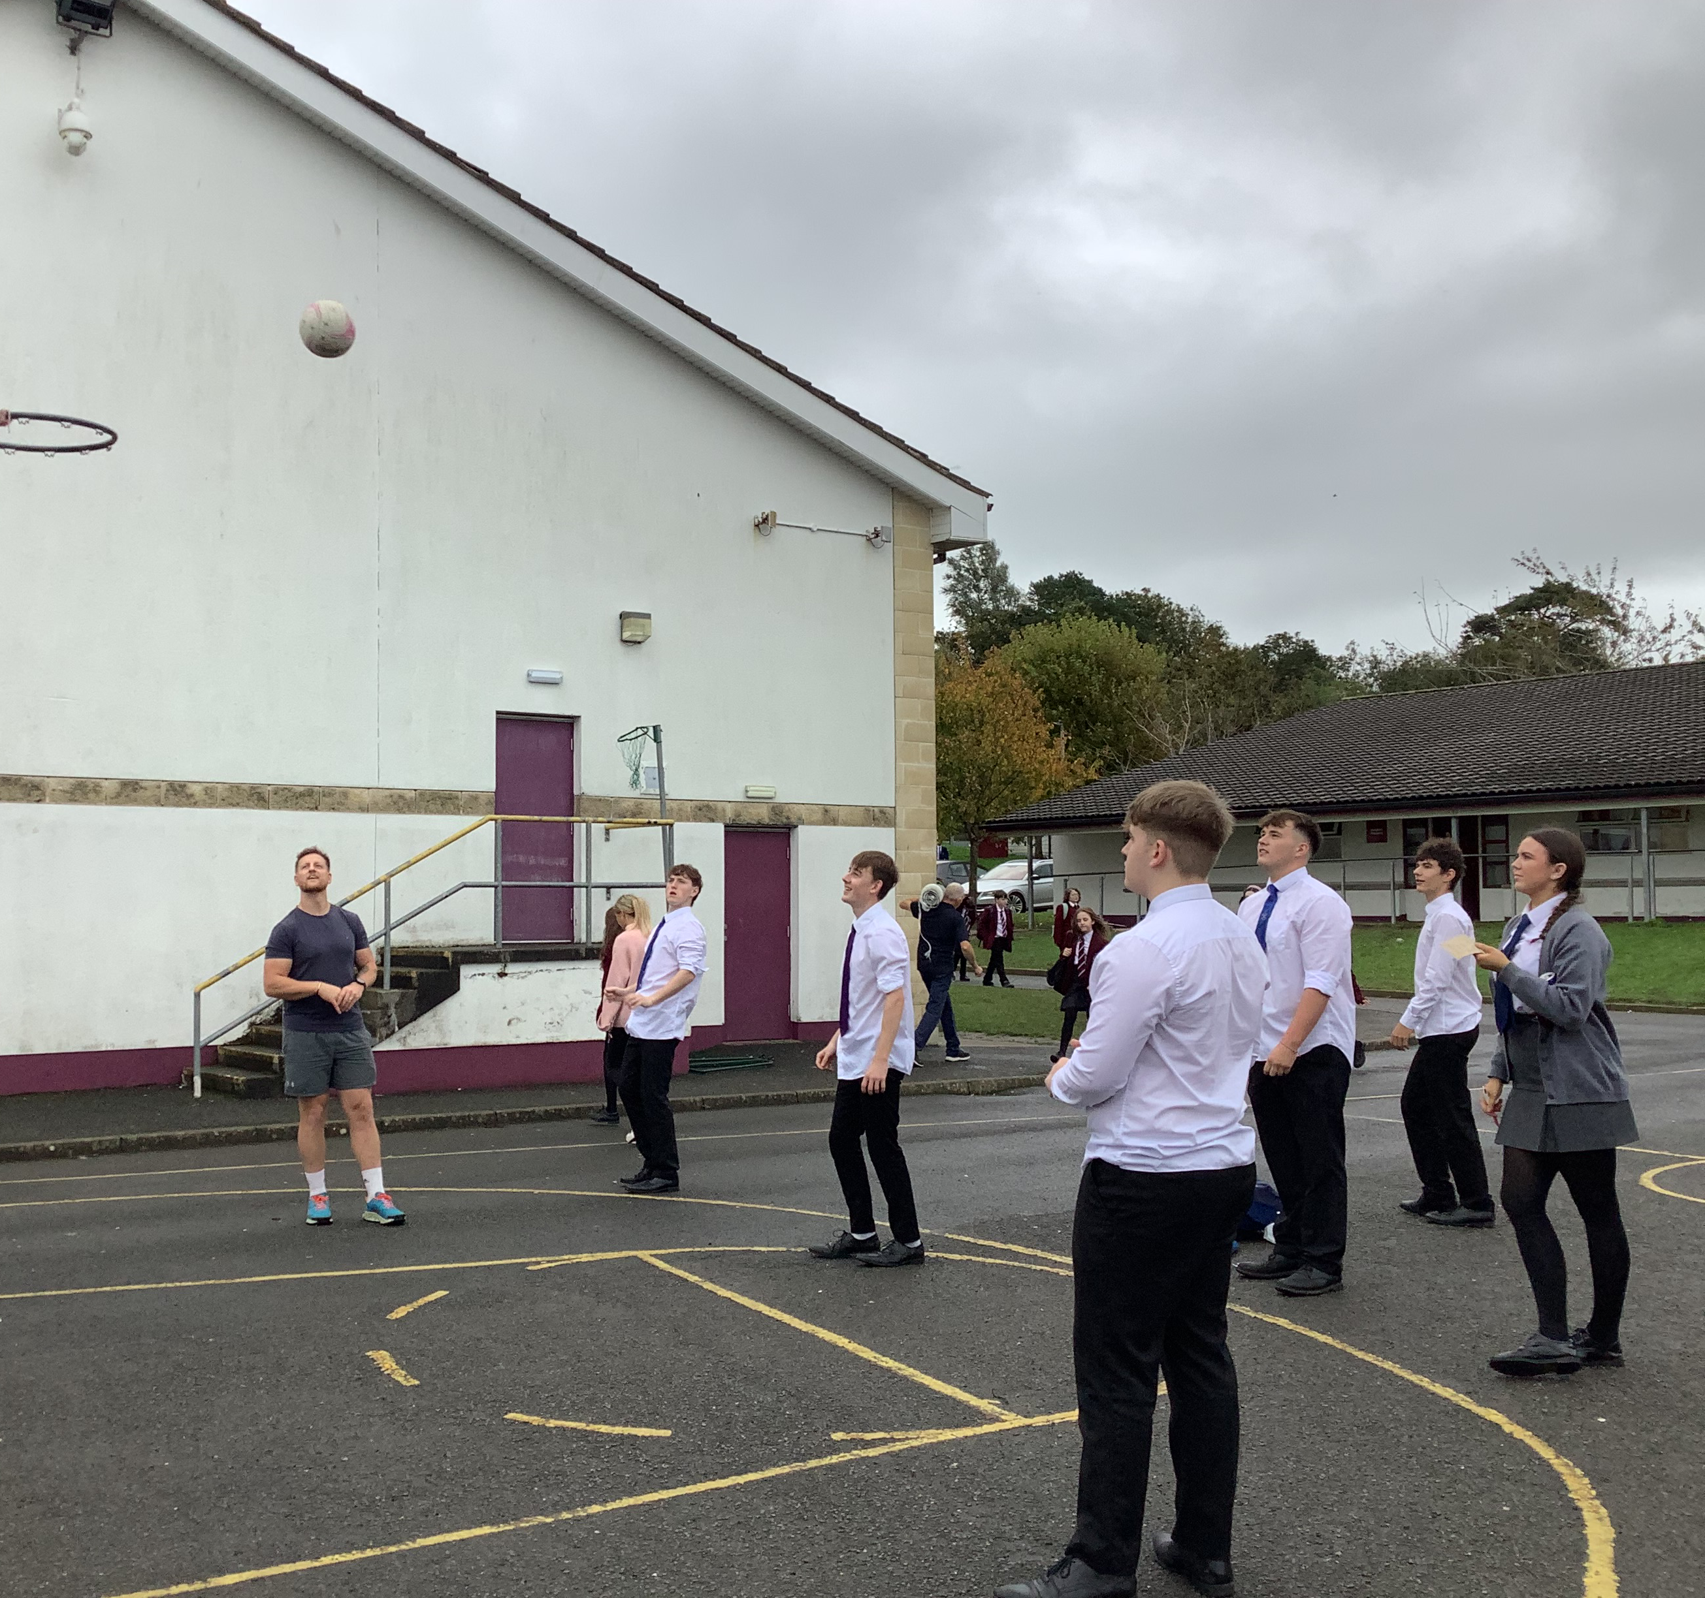
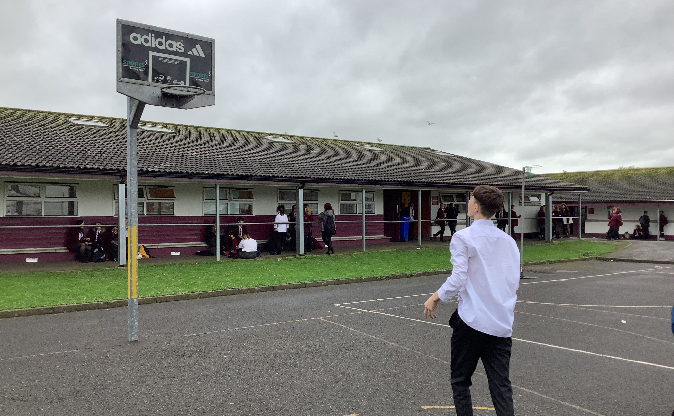
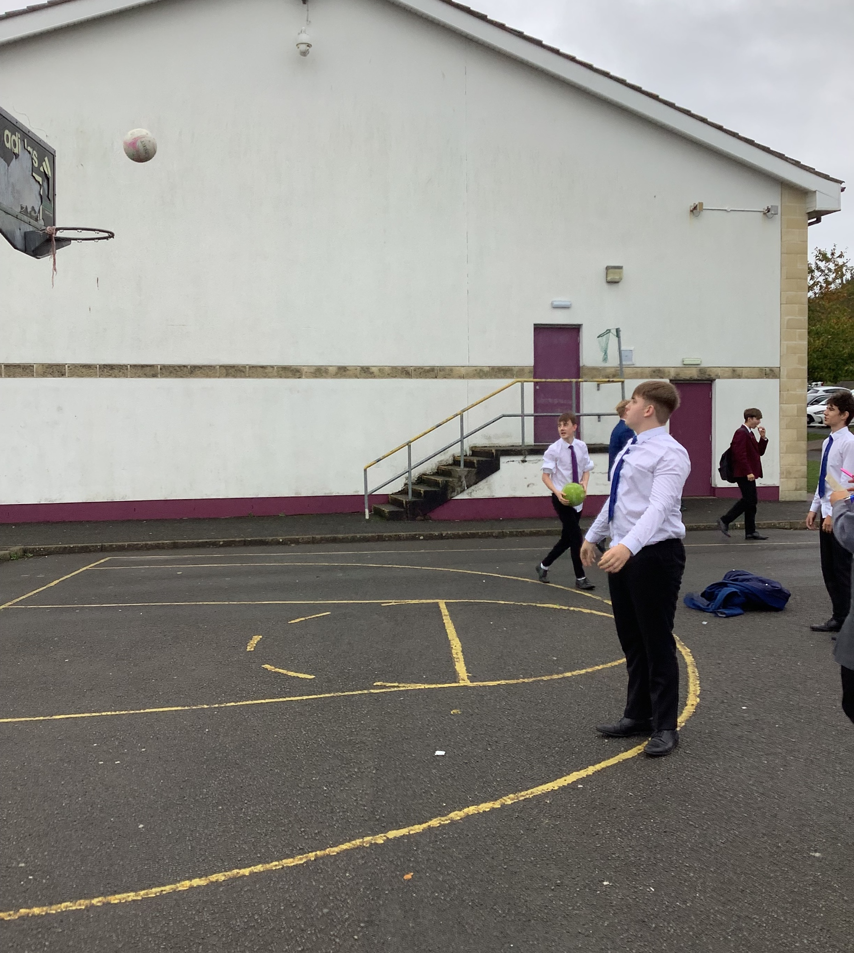
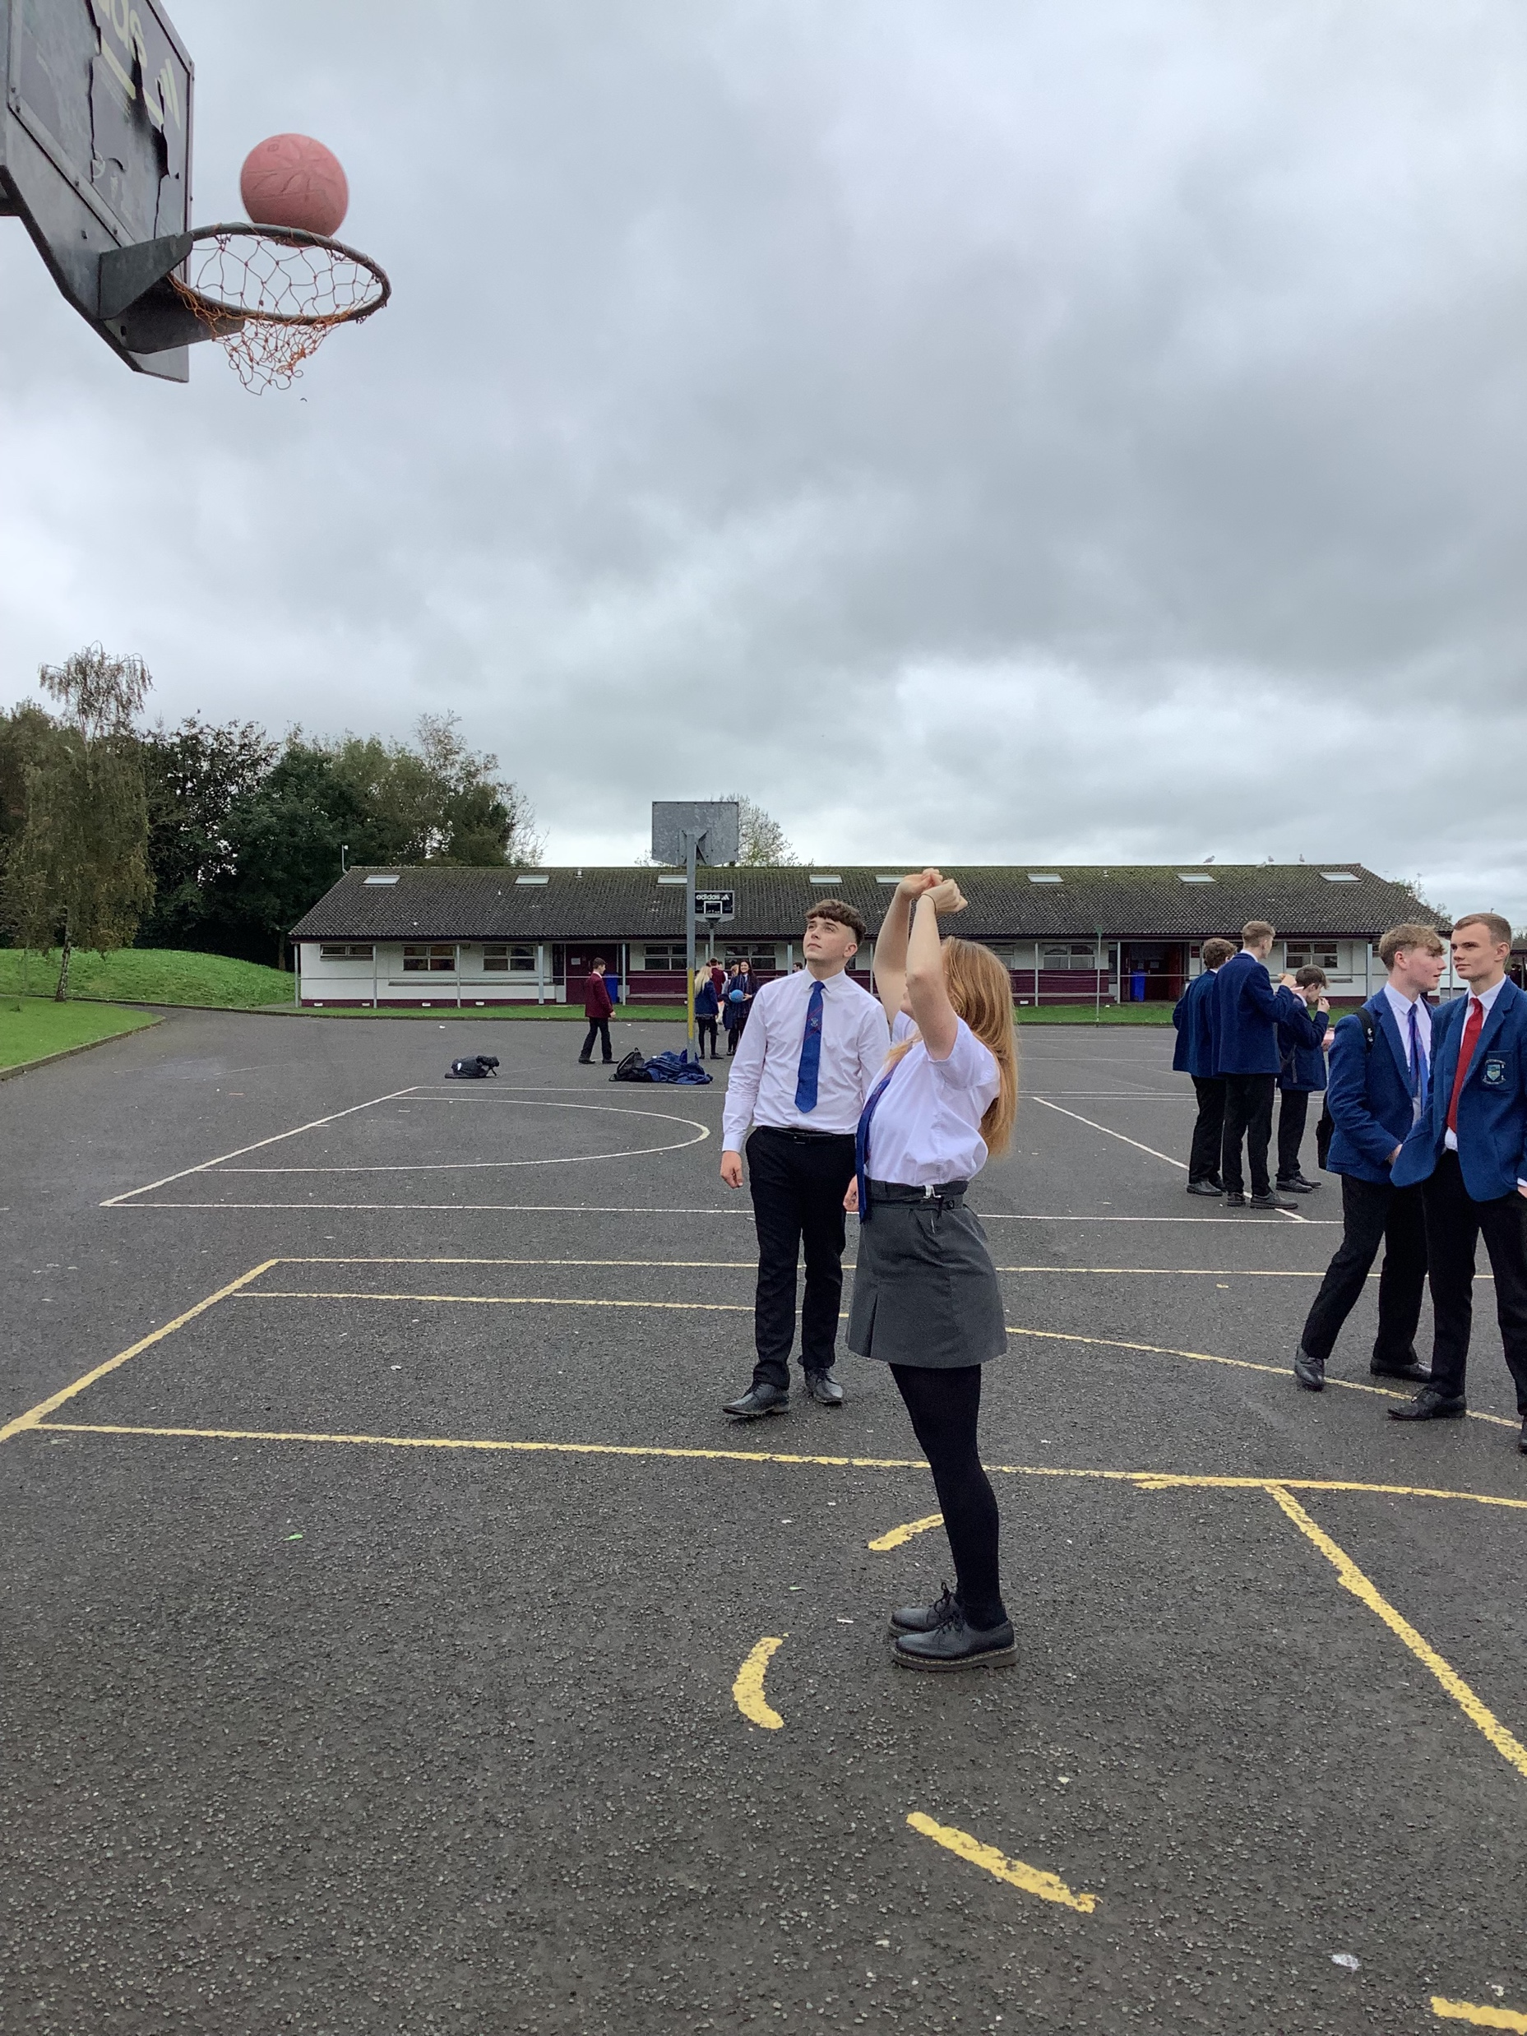
'GOALS FOR GLORY'
RESULTS
 | O | S | M | T
JUNIOR | 1st | 3rd | 2nd | 4th
SENIOR | 3rd | 4th | 2nd | 1st
"A great turnout from junior and senior school and some great teamwork. Well done to everyone who took part."

